Slide 1
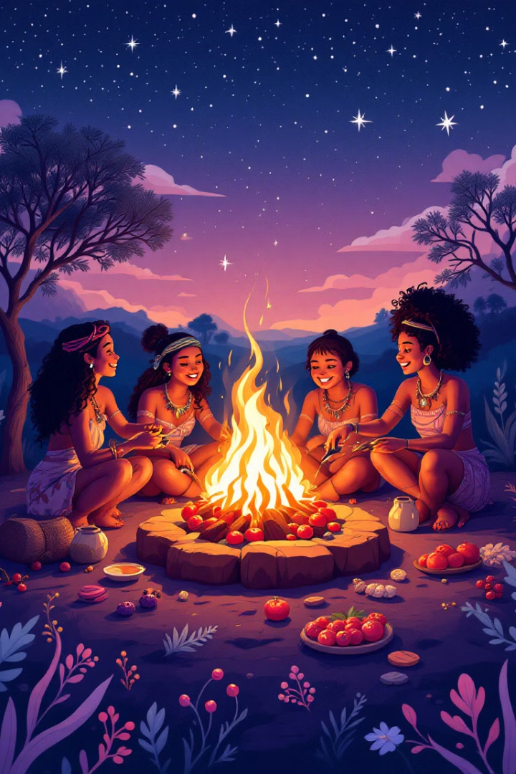
Verbs vs Adverbs: Mastering Language in the Australian Bush Tucker
Explore the power of verbs and adverbs to bring your bush tucker descriptions to life. Learn how to use these essential parts of speech effectively in your writing.
CB
by Craig Blair

Slide 2
What are verbs and adverbs?
1
Verbs
2
Adverbs
3
Descriptive Power
Verbs are action words that describe what a person or thing is doing. Example: "The kangaroo *hops* across the plains."
Adverbs modify verbs by adding more information about how, when, or where the action takes place. Example: "The kangaroo *quickly* hops across the plains."
Together, verbs and adverbs paint vivid pictures with words, engaging the reader's imagination.

Slide 3
The importance of verbs and adverbs in describing bush tucker
Visual Appeal
Sensory Details
Engaging Narratives
Verbs and adverbs help you create a strong visual image for the reader. "The bush tomato *glistens* *red* on the vine."
They can also appeal to other senses, bringing your descriptions to life. "The witchetty grub *crackles* *deliciously* as it *fries* over the fire."
By using descriptive language, you can create engaging narratives that transport your readers to the Australian bush.

Slide 4
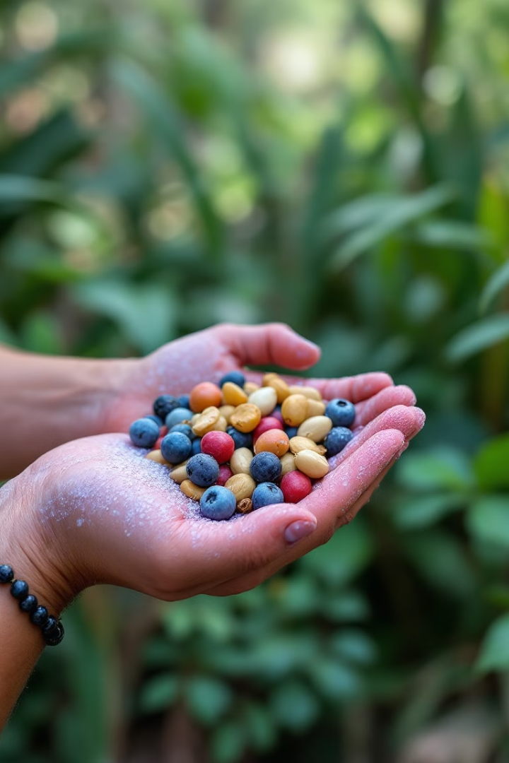
Examples of verbs and adverbs used in bush tucker recipes
Verb
Adverb
Example
Grind
Finely
Finely grind the quandong seeds for a flavorful powder.
Roast
Slowly
Slowly roast the wattle seeds until they are fragrant.
Boil
Gently
Gently boil the native berries to create a sweet syrup.

Slide 5
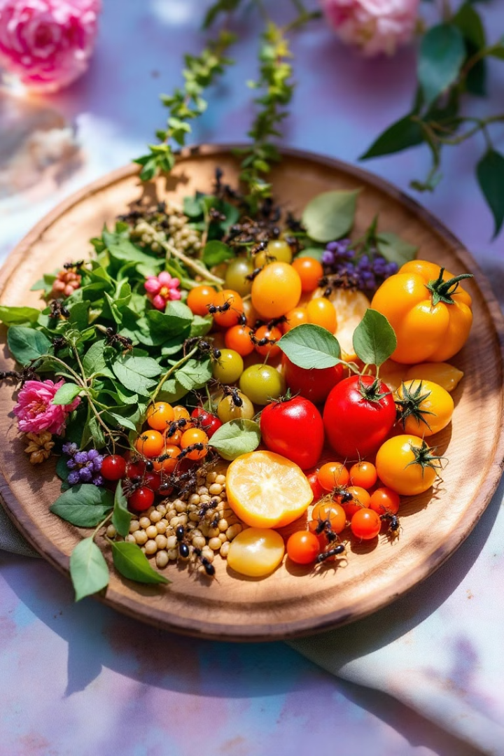
Crafting vivid descriptions with verbs and adverbs
Choose the right verbs
Select verbs that accurately describe the action. Avoid weak verbs like "is" or "was."
Use descriptive adverbs
Add detail to your verbs by using adverbs that tell how, when, or where the action takes place.
Combine verbs and adverbs
Create powerful descriptions by combining strong verbs with precise adverbs. "The honey ants *buzz* *eagerly* in the sun."

Slide 6
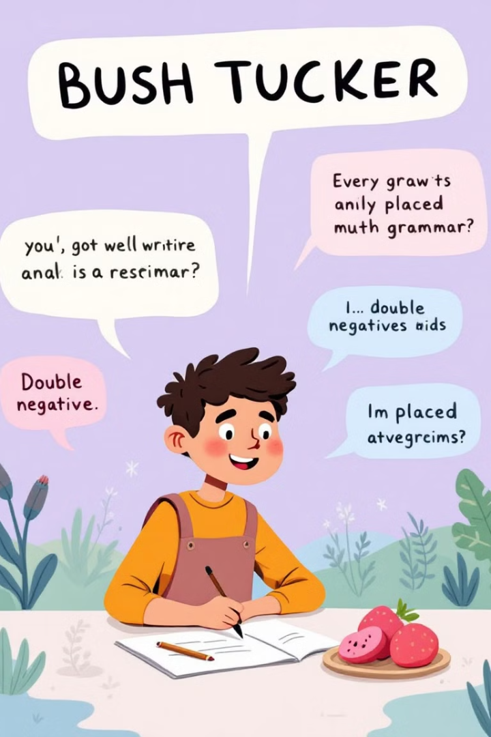
Common mistakes students make with verbs and adverbs
Double Negatives
Misplaced Adverbs
Avoid using two negatives in a sentence. "I didn't *never* taste bush tomato before." should be "I have *never* tasted bush tomato before."
Make sure adverbs are placed close to the words they modify. "I *quickly* ate the bush tomato" is more accurate than "I ate the bush tomato *quickly*."
Overuse of Adverbs
Use adverbs sparingly to avoid cluttering your writing. "The *extremely* delicious bush tomato *really* tasted *very* good" is too wordy. Instead, try "The bush tomato tasted delicious."

Slide 7
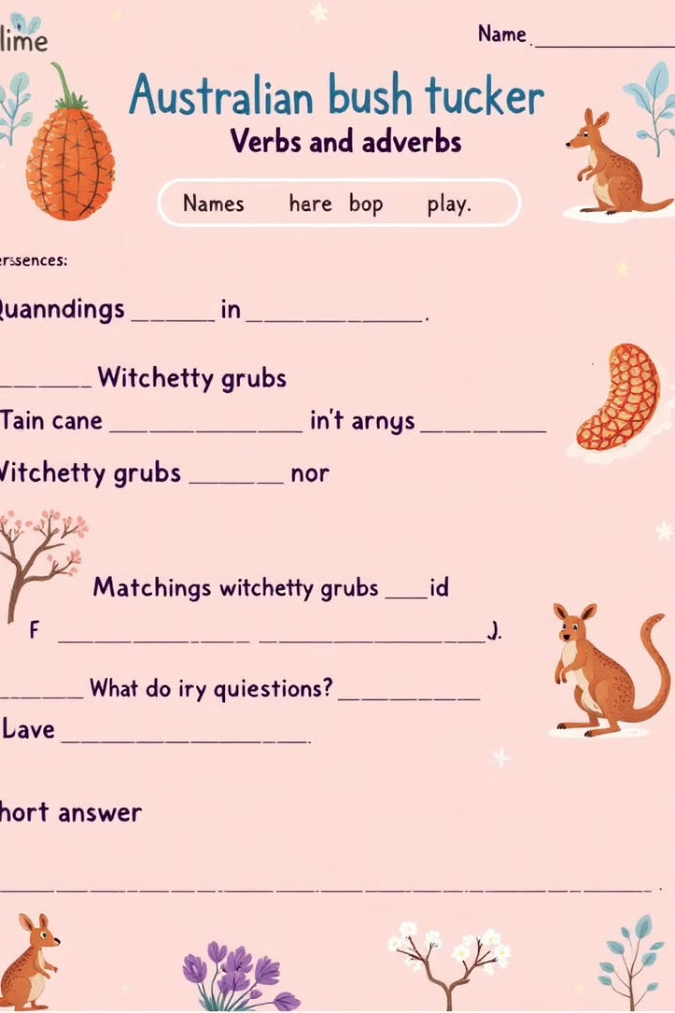
Exercises to practice using verbs and adverbs effectively
1
Descriptive Sentences
Write sentences that describe the appearance, taste, and texture of different bush tucker ingredients. Example: "The witchetty grub *sizzles* *appetizingly* on the fire."
2
Sensory Details
Write a paragraph about a bush tucker experience, using verbs and adverbs to evoke the senses of sight, sound, smell, taste, and touch.
3
Creative Writing
Write a short story about a bush tucker gathering, incorporating vivid verbs and adverbs to create a compelling narrative.

Slide 8
Applying verb and adverb skills to your own bush tucker writing
Practice regularly
Write descriptions of bush tucker ingredients and recipes, using verbs and adverbs effectively. The more you practice, the more confident you will become.
Seek feedback
Ask a teacher or peer to review your writing and offer suggestions for improvement. This can help you identify areas where you can strengthen your use of verbs and adverbs.
Read widely
Explore Australian literature and other writing about food, nature, and culture to learn from experienced writers and observe their use of verbs and adverbs.

