Slide 1
Verbs vs. Adverbs: Exploring Australian Bush Tucker
Discover the rich vocabulary used to describe the preparation and consumption of traditional Australian bush foods, known as "bush tucker." In this presentation, we'll dive into the nuances between verbs and adverbs that bring these culinary experiences to life.
by Craig Blair

Slide 2
Understanding the Australian Bush
Diverse Ecosystems
Indigenous Knowledge
The Australian bush encompasses a wide variety of landscapes, from dense forests to arid deserts, each with its own unique flora and fauna.
Aboriginal Australians have a deep understanding of the bush, utilizing its resources for food, medicine, and cultural practices for thousands of years.

Slide 3
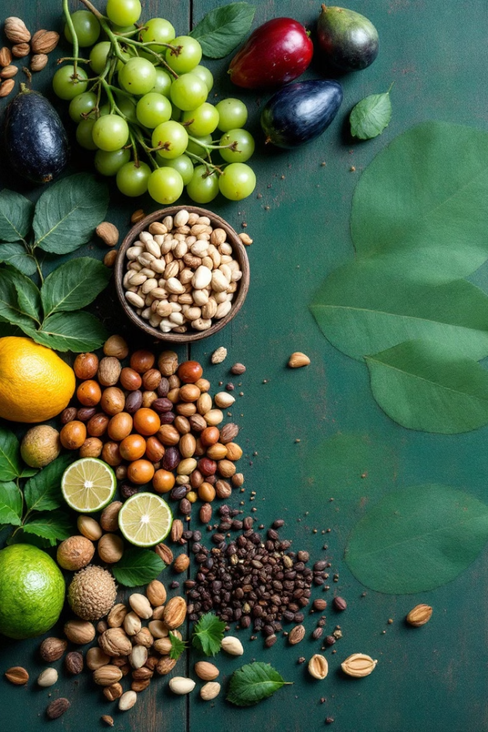
Characteristics of Bush Tucker
Diverse Ingredients
Nutritional Value
Many bush tucker foods are rich in essential vitamins, minerals, and nutrients, making them a valuable part of a healthy diet.
Bush tucker encompasses a wide range of edible plants, animals, and fungi found in the Australian wilderness.
Unique Flavors
Bush tucker ingredients often have distinct, earthy, or unexpected flavors that set them apart from commercial produce.

Slide 4
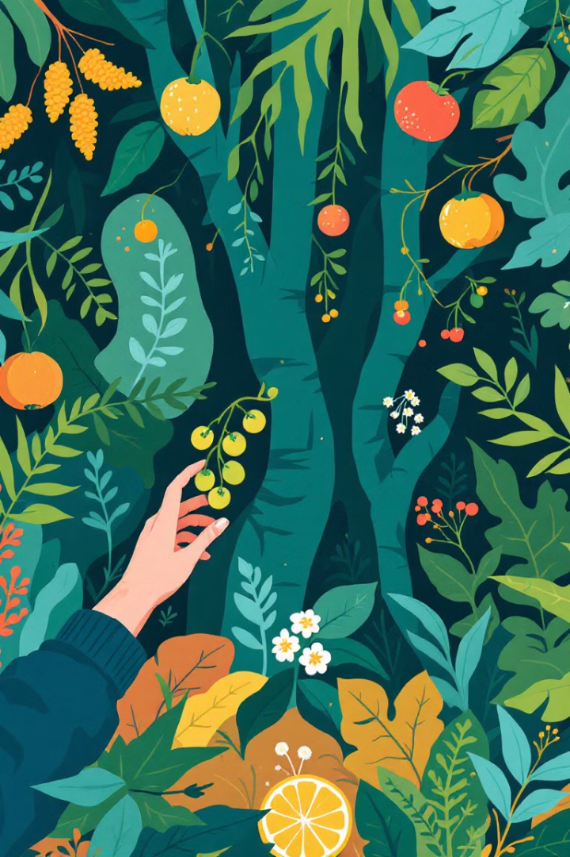
Verbs Describing Bush Tucker Preparation
1
Harvest
2
Forage
Carefully collect bush tucker ingredients from their natural environment.
Scavenge and search for edible plants and animals in the bush.
3
Cook
Prepare bush tucker using traditional methods like roasting, steaming, or smoking.

Slide 5
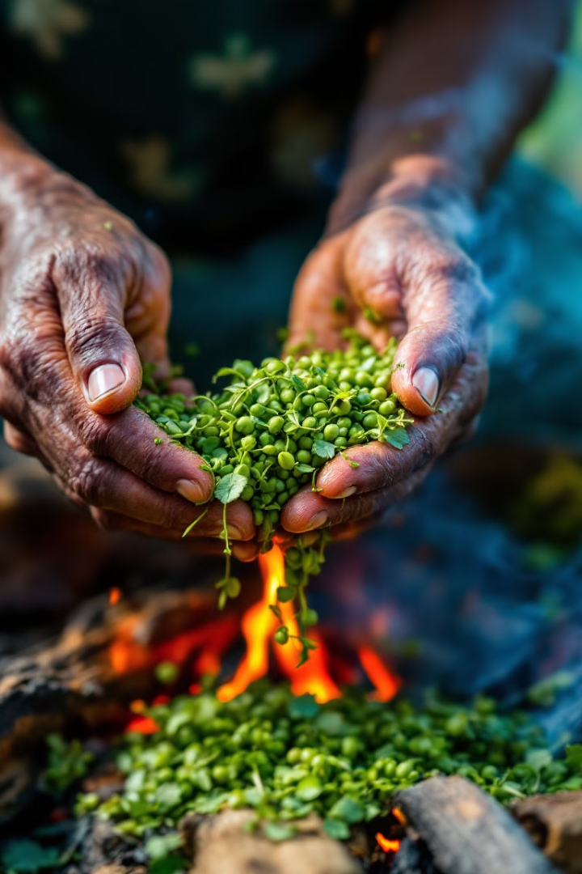
Adverbs Modifying Bush Tucker Actions
Carefully
Harvest bush tucker ingredients with precision to avoid damage.
Traditionally
Cook bush tucker using time-honored methods passed down for generations.
Sustainably
Forage for bush tucker while preserving the natural environment.

Slide 6
Choosing the Appropriate Verb or Adverb
Precision
1
Select verbs and adverbs that accurately describe the specific actions and techniques used in bush tucker preparation.
Context
2
Consider the cultural, environmental, and historical context of bush tucker to choose the most appropriate language.
Nuance
3
Understand the subtle differences between similar verbs and adverbs to convey the intended meaning.

Slide 7
Practical Examples of Bush Tucker Vocabulary
1
Carefully forage
Gather bush tucker ingredients with great care to preserve the natural environment.
2
Traditionally cook
Prepare bush tucker using time-honored methods passed down through generations.
3
Sustainably harvest
Collect bush tucker ingredients in a way that ensures the long-term viability of the resource.

Slide 8
Applying Verb and Adverb Skills in Bush Tucker Contexts
3
1
2
Steps
Precision
Nuance
Mastering the use of verbs and adverbs can enhance your ability to accurately describe and appreciate the traditional practices of bush tucker.
Choose the right verbs and adverbs to convey the specific actions and techniques involved in bush tucker preparation.
Understand the subtle differences between similar terms to ensure your language reflects the cultural and environmental context.

